Slide 1





Brain Tumor Detection
Team Members: Kundrapu.Renuka durga Guide : Abdul Aziz Sir
Nagireddy.Hemalatha
Peketi.Sivakanya
Vannelaba.Varalaxmi
Disclaimer: The content is curated for educational purposes only.

Slide 2
OUTLINE
Abstract
Problem Statement
Aims, Objective & Proposed System/Solution
System Design/Architecture
System Development Approach (Technology Used)
Algorithm & Deployment
Conclusion
Future Scope
References
Video of the Project
Notes:
These are the list of chapters that we are going to cover in these foundation codes. Those are chapter one what are AI and ML? chapter 2 applied Python programming in AI, and chapter 3 is exploratory data analysis for ML.

Slide 3
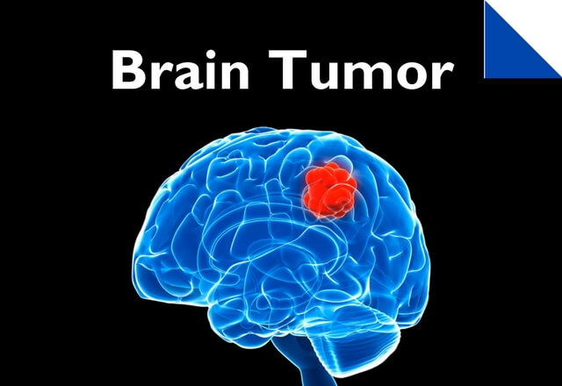
Abstract : Detection and Classification of a brain tumor is an important step to better understanding its mechanism. Magnetic Reasoning Imaging (MRI) is an experimental medical imaging technique that helps the radiologist find the tumor region. However, it is a time taking process and requires expertise to test the MRI images, manually . Therefore This project bring forth the novel image processing based approach for the diagnosis of brain tumor . retaining the fine details as well as texture, and generates noise-free images. The images undergoes the pre-processing function using adaptive noise fuzzy switching median filter. It removes the black and white noise in the input image while retaining the fine details as well as texture, and generates noise-free images.

Slide 4
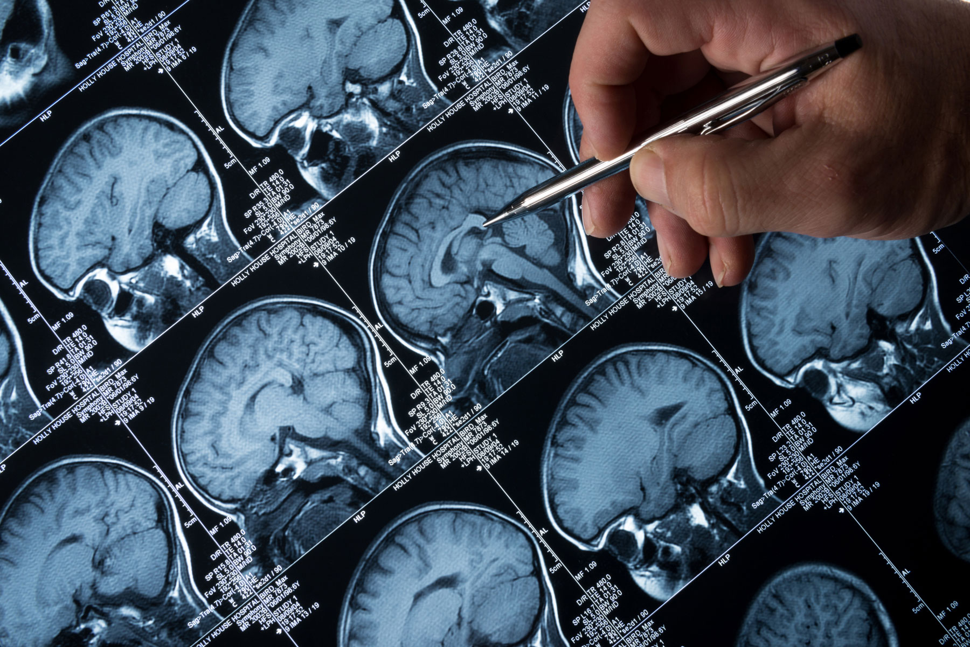
Problem Statement : Brain tumor is one of the deadliest illnesses which occurs due to the sudden and unregulated brain tissue growth inside the skull. It can be either benign or malignant. Malignant tumors can expand quickly and disperse across the surrounding brain tissue, whereas benign tumors tend to grow slowly. However, benign tumors can also be dangerous as their proliferation may affect surrounding brain tissues.so early diagnosis of a brain tumor is essential due to its deadly aspect

Slide 5
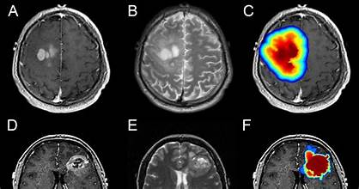
Aim and Objective : The main aim of brain tumor detection is to identify accurately and locate abnormal growths of tumor within the brain And Its main objective is to detect tumor at an early stage, enabling timely treatment and improving patient survival outcomes.

Slide 6
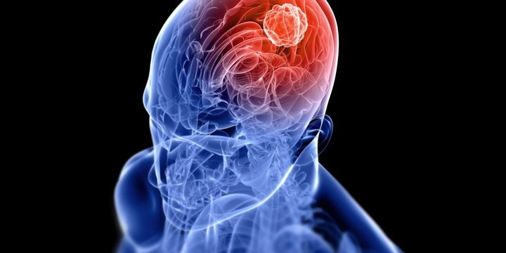
Proposed Solution: the main challenge lies in integrating effective image processing algorithms and machine learning models seamlessly into a web-based application. To address this, the project can leverage popular Python libraries such as TensorFlow or PyTorch for machine learning and OpenCV for image processing. The Flask framework can be used to create a user-friendly web interface that allows users to upload MRI or CT scan images. On the server side, the uploaded images can be processed using pre- trained machine learning models for tumor detection. The predictions can then be communicated back to the user through the Flask web application.Proper documentation and modular code structure will also facilitate future updates and improvements. Overall, this solution ensures a smooth integration of brain tumor detection algorithms into a user-friendly web application using the Python and Flask stack

Slide 7
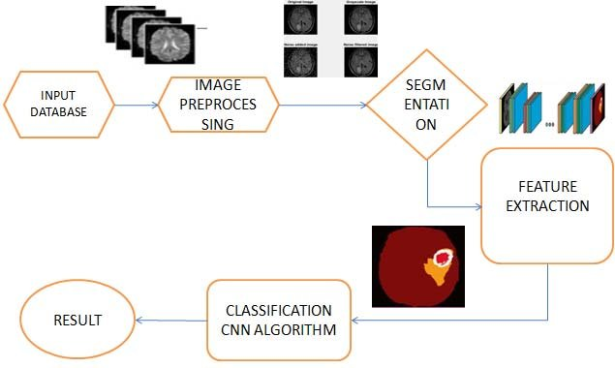
System Architecture

Slide 8
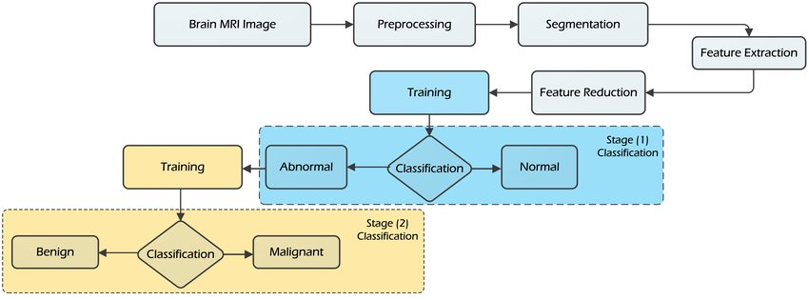
System Architecture

Slide 9
System Deployment Approach: Developing a brain tumor detection system involves leveraging various technologies and methodologies.
Data Collection: Gather a diverse dataset of brain MRI or CT scans that contain tumor and non-tumor images.
Preprocessing: Clean the images, normalize intensities, and resize them to a standard format.
Feature Extraction: Utilize techniques like convolutional neural networks (CNNs) to automatically extract meaningful features from the images.
Model Training: Train the model using labeled data, employing architectures like CNNs due to their effectiveness in image analysis .
Validation and Tuning: Validate the model's performance using a separate dataset, fine-tuning hyperparameters if needed to enhance accuracy.
Deployment: Implement the model into a user-friendly interface, potentially as a web or mobile application. Ensure it complies with healthcare regulations and maintains patient data privacy.

Slide 10
Deployment:
Technology: Utilize Python with libraries like TensorFlow, Keras, or PyTorch for model development.
User Interface : Develop an intuitive interface for medical professionals to upload images and receive automated predictions .
Validation: Collaborate with medical experts to validate the system's accuracy and ensure it aligns with medical standards .
Ethical Considerations: Prioritize patient data privacy and ensure compliance with medical regulations (like HIPAA in the US) when handling medical information.

Slide 11
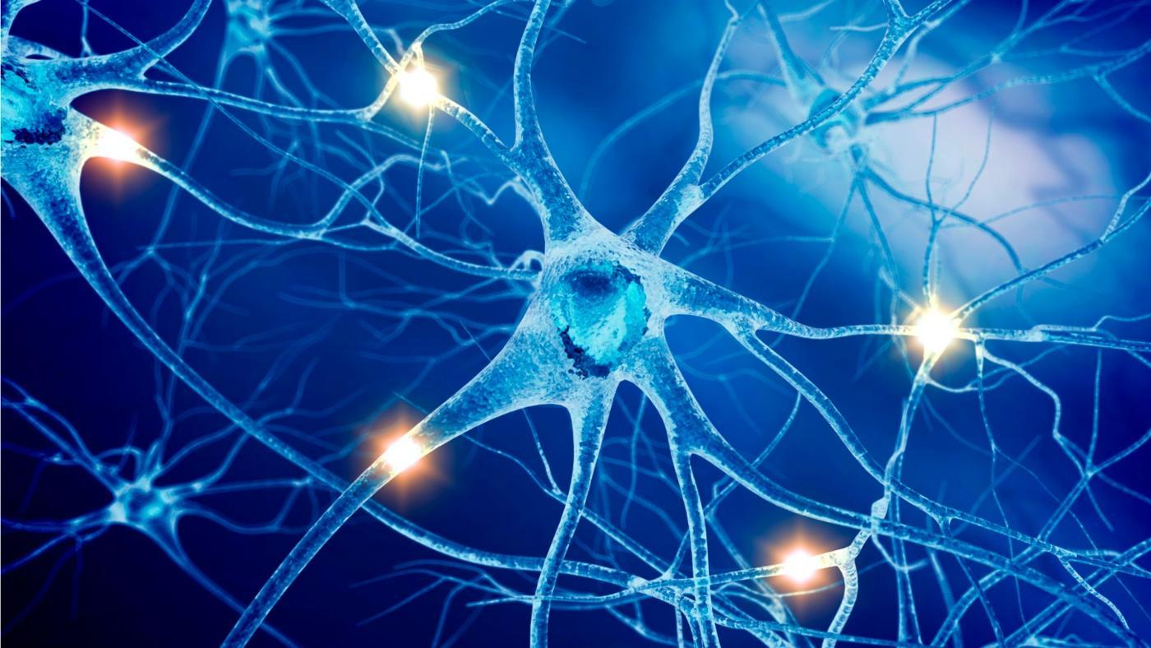
Algorithm & Deployment:
Backend development : Setup, Model Integration, Data Handling
Frontend development : UI- Design, Upload Functionality, Display results
Deployment: flask deployment, integration and security
Techologies: flask, html & css , machine learning, deployment services

Slide 12
Conclusion:
Brain tumor MRI image is applied to preprocessing and after the tumor extracted through training and testing in ml.
The medical image detection has difficulties in detecting complex structure with uneven shape, size and properties.
For accurate diagnosis of tumor patients, appropriate detection method is required to be used for MRI images and carry out an improved diagnosis and treatment.
The brain tumor detection is a great help for the physician as a boon for a medical imaging and industries working on the production of MRI images

Slide 13
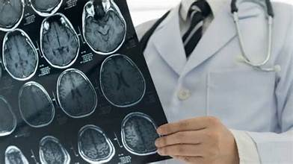
Future Scope: Although our proposed models achieved promising classification outcomes, there are still a number of issues that can be resolved in the future work . for example,
Improvement in ml models
Focusing on developing algorithms capabilities
so Early – stage detection tumor can be detected.
Multi-modal fusion so that we input multiple images
such as MRI,CT,PET..
Improving python code so user can see the image
of Brain tumor that is detected

Slide 14
Reference
https://github.com/MohamedAliHabib/Brain-Tumor-Detection/blob/master/.ipynb_checkpoints/Brain%20Tumor%20Detection-checkpoint.ipynb
https://www.youtube.com/watch?v=Gc6MSamMtRo
Notes:
Reference
These are the references for this session.
14

Slide 15
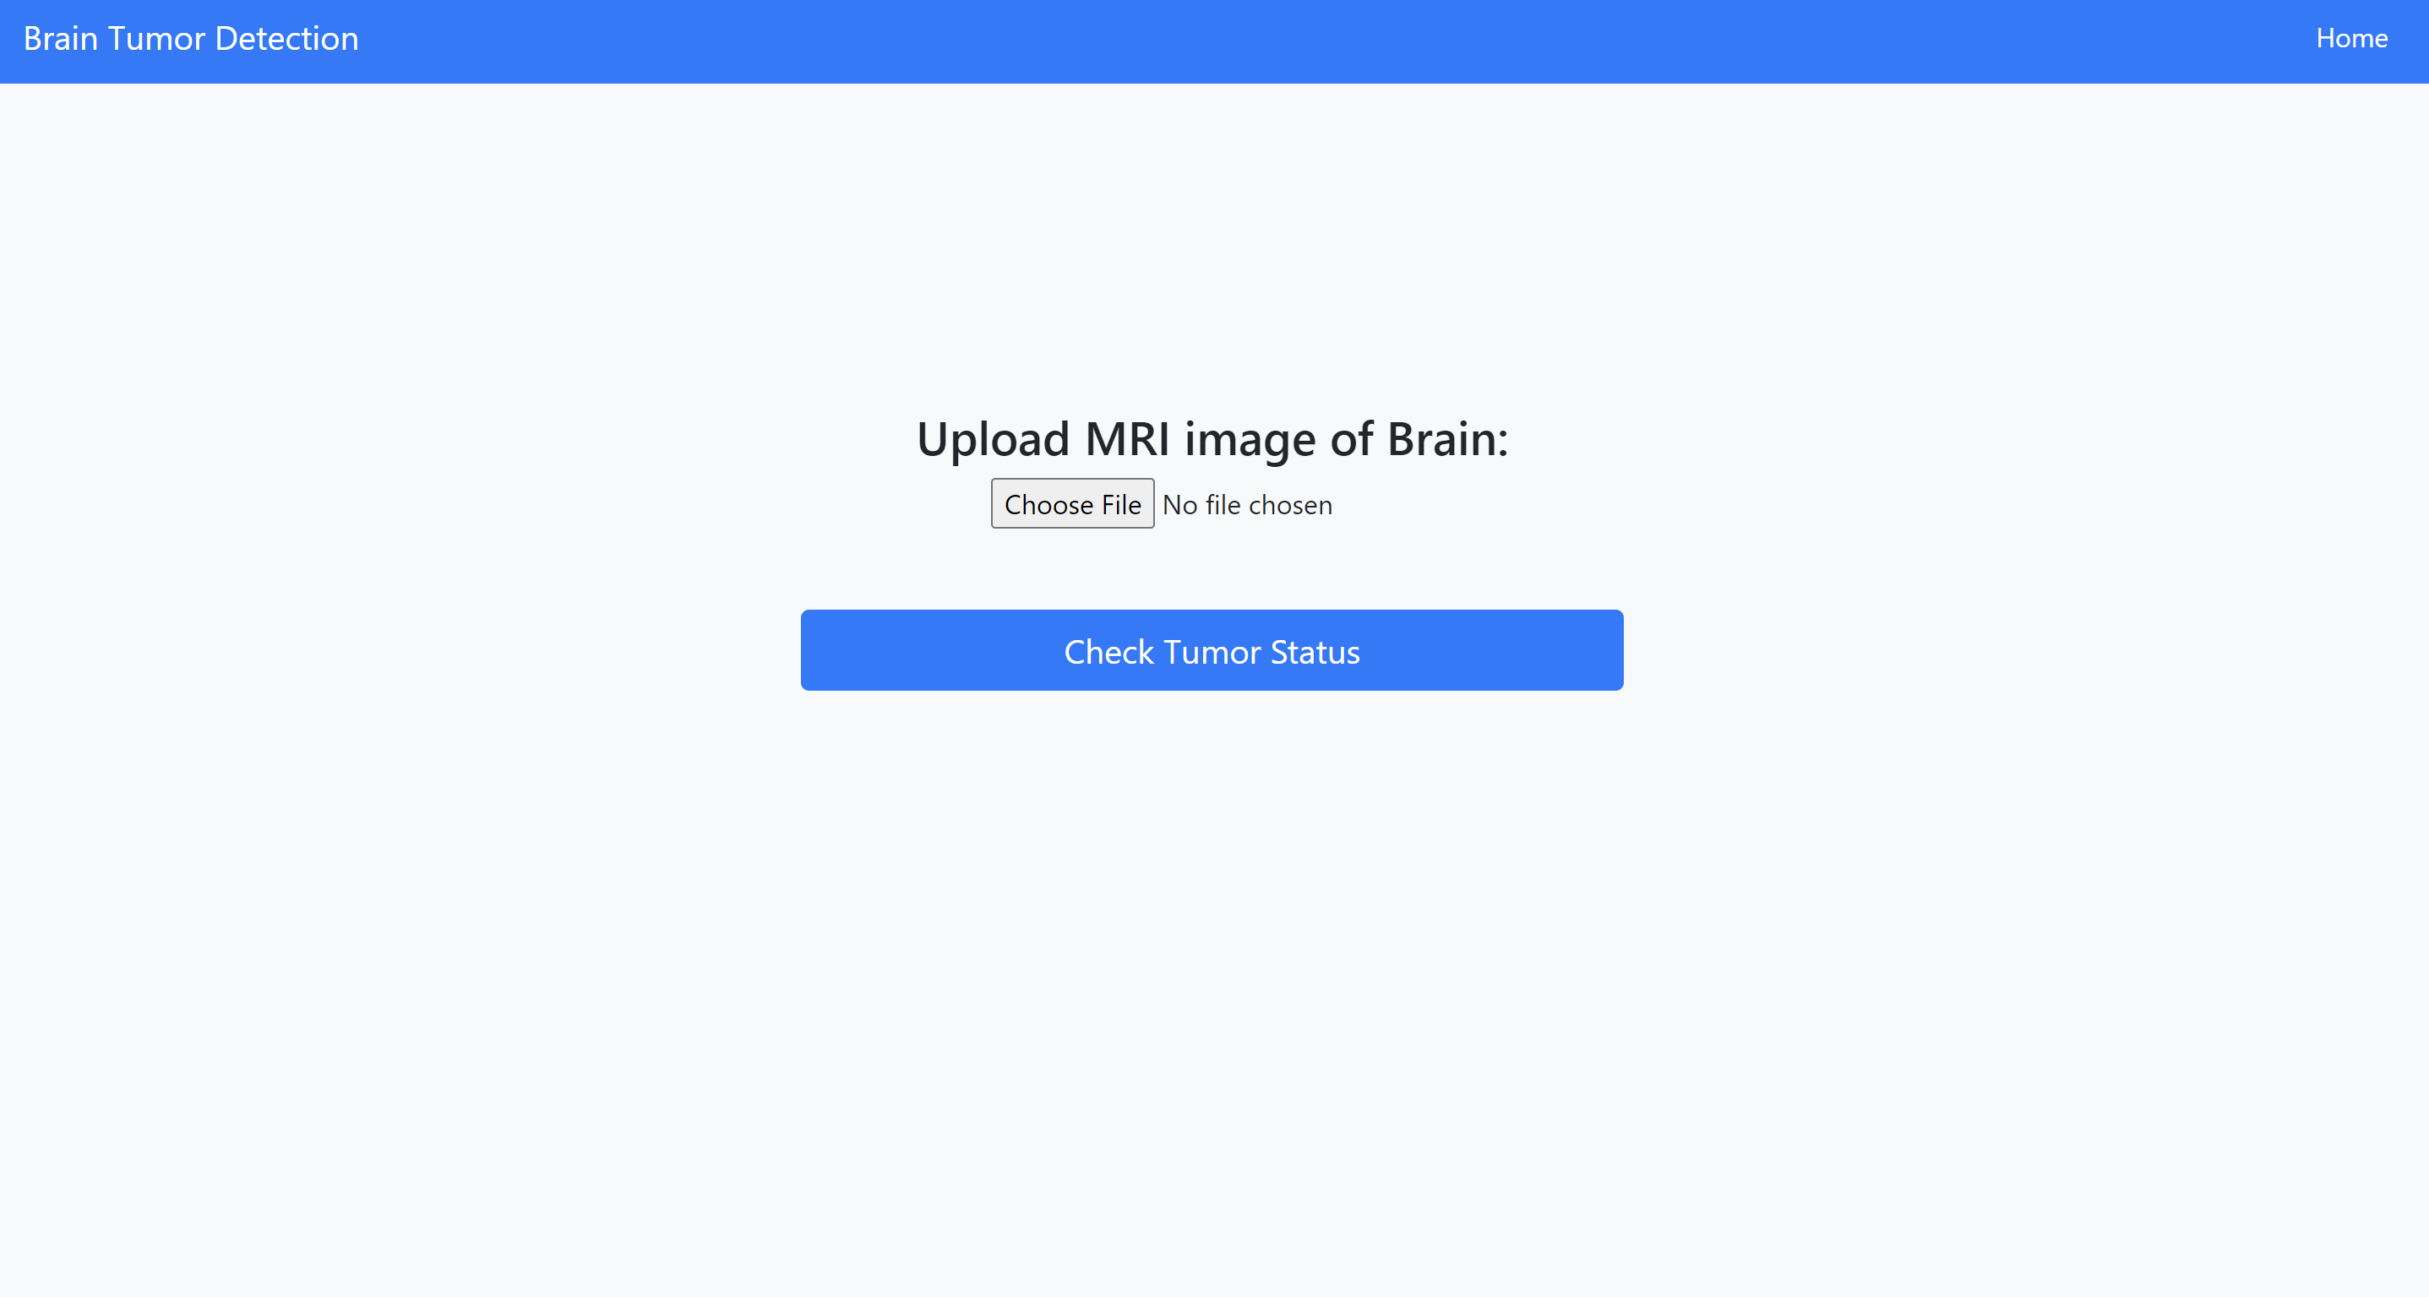

Slide 16
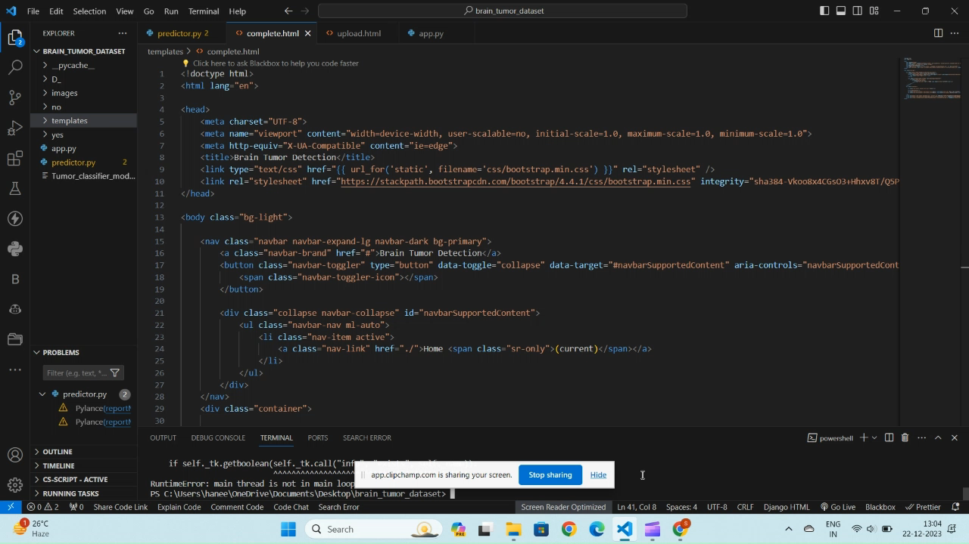
vedio

Slide 17

Thank you!
Notes:
thank you very much for joining this PPT, keep learning.
17

